Slide 1
Problem 7.1 P298
(a).
(b).

Slide 2




Problem 7.2 P298

Slide 4
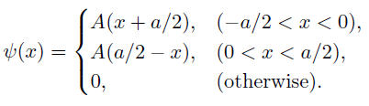
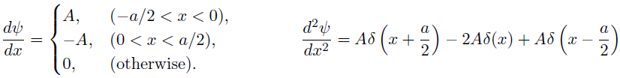

Problem 7.3 P298

Slide 5


Slide 6













Problem 7.4 P298
(a).
(b).

Slide 7



Problem 7.5 P299
(a).
(b).
always negative
Problem 7.6 P303

Slide 8



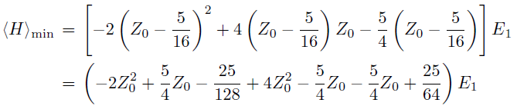

Problem 7.7 P303

Slide 9




Slide 10


Problem 7.11 P309
(a).

Slide 11




(b).

Slide 12




Slide 13





Problem 7.13 P310

Slide 14


Slide 15








Problem 7.14 P310

Slide 16
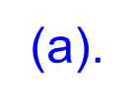








Problem 7.17 P312

Slide 17
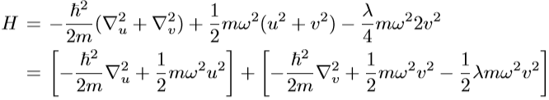





(b).
(c).

Slide 18
Home work: problem15,16

